Slide 1
Introduction to HTML Part 2

Slide 2
Lists
In this chapter you will learn how to create a variety of lists.
Objectives
Upon completing this section, you should be able to
Create an unordered list.
Create an ordered list.
Create a defined list.
Nest Lists.

Slide 3
List Elements
HTML supplies several list elements. Most list elements are composed of one or more <LI> (List Item) elements.
UL : Unordered List. Items in this list start with a list mark such as a bullet. Browsers will usually change the list mark in nested lists.
<UL>
<LI> List item …</LI>
<LI> List item …</LI>
</UL>
List item …
List item …

Slide 4
List Elements
You have the choice of three bullet types: disc(default), circle, square.
These are controlled in Netscape Navigator by the “TYPE” attribute for the <UL> element.
<UL TYPE=“square”>
<LI> List item …</LI>
<LI> List item …</LI>
<LI> List item …</LI>
</UL>
List item …
List item …
List item …

Slide 5
List Elements
OL: Ordered List. Items in this list are numbered automatically by the browser.
<OL>
<LI> List item …</LI>
<LI> List item …</LI>
<LI> List item …</LI>
</OL>
List item …
List item …
List item
You have the choice of setting the TYPE Attribute to one of five numbering styles.

Slide 6
List Elements
TYPE | Numbering | Styles
1 | Arabic numbers | 1,2,3, ……
a | Lower alpha | a, b, c, ……
A | Upper alpha | A, B, C, ……
i | Lower roman | i, ii, iii, ……
I | Upper roman | I, II, III, ……

Slide 7
List Elements
You can specify a starting number for an ordered list.
<OL TYPE =“i”>
<LI> List item …</LI>
<LI> List item …</LI>
</OL>
<P> text ….</P>
<OL TYPE=“i” START=“3”>
<LI> List item …</LI>
</OL>

Slide 8
List Elements
List item …
List item …
Text ….
List item …

Slide 9
List Elements
DL: Definition List. This kind of list is different from the others. Each item in a DL consists of one or more Definition Terms (DT elements), followed by one or more Definition Description (DD elements).
<DL>
<DT> HTML </DT>
<DD> Hyper Text Markup Language </DD>
<DT> DOG </DT>
<DD> A human’s best friend!</DD>
</DL>
HTML
Hyper Text Markup Language
DOG
A human’s best friend!

Slide 10
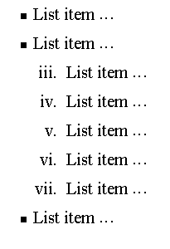
Nesting Lists
You can nest lists by inserting a UL, OL, etc., inside a list item (LI).
EXample
<UL TYPE = “square”>
<LI> List item …</LI>
<LI> List item …
<OL TYPE=“i” START=“3”>
<LI> List item …</LI>
<LI> List item …</LI>
<LI> List item …</LI>
<LI> List item …</LI>
<LI> List item …</LI>
</OL>
</LI>
<LI> List item …</LI>
</UL>

Slide 11
What will be the output?
<H1 ALIGN="CENTER">SAFETY TIPS FOR CANOEISTS</H1> <OL TYPE=“a” START=“2”> <LI>Be able to swim </LI> <LI>Wear a life jacket at all times </LI> <LI>Don't stand up or move around. If canoe tips,
<UL> <LI>Hang on to the canoe </LI> <LI>Use the canoe for support and </LI> <LI>Swim to shore </UL> </LI>
<LI>Don't overexert yourself </LI> <LI>Use a bow light at night </LI> </OL>

Slide 12
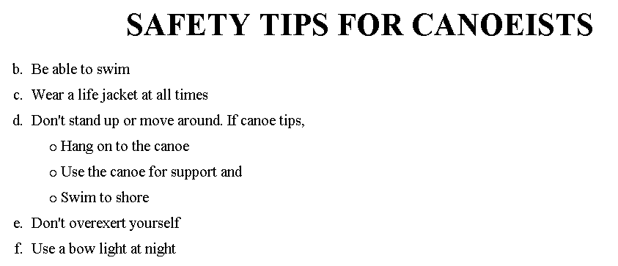
The output….

Slide 13
<H1 ALIGN="CENTER">SAFETY TIPS FOR CANOEISTS</H1>
<OL TYPE="a" START="2">
<LI>Be able to swim </LI>
<LI>Wear a life jacket at all times </LI>
<LI>Don't stand up or move around. If canoe tips,
<UL>
<LI>Hang on to the canoe </LI>
<LI>Use the canoe for support
<OL type="I" start="4">
<LI> Be careful </LI>
<LI> Do not look around</LI>
</LI> </OL>
<LI>Swim to shore
</UL> </LI>
<LI>Don't overexert yourself </LI>
<LI>Use a bow light at night </LI>
</OL>
What
will
be the
output?

Slide 14
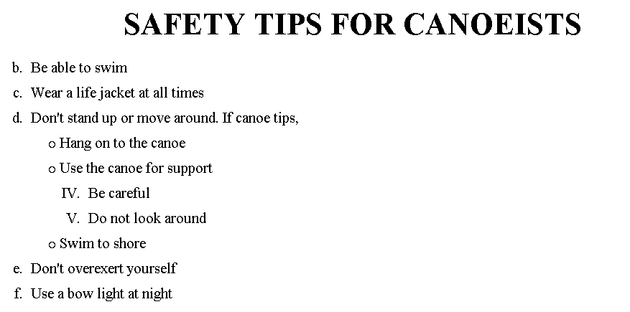
The output….

Slide 15
Forms
Forms add the ability to web pages to not only provide the person viewing the document with dynamic information but also to obtain information from the person viewing it, and process the information.
Objectives:
Upon completing this section, you should be able to
Create a FORM.
Add elements to a FORM.
Define CGI (Common Gateway Interface).
Describe the purpose of a CGI Application.
Specify an action for the FORM.
Forms work in all browsers.
Forms are Platform Independent.

Slide 16
Forms
To insert a form we use the <FORM></FORM> tags. The rest of the form elements must be inserted in between the form tags.
<HTML> <HEAD>
<TITLE> Sample Form</TITLE>
</HEAD>
<BODY BGCOLOR=“FFFFFF”>
<FORM ACTION = http://www.xnu.com/formtest.asp>
<P> First Name: <INPUT TYPE=“TEXT” NAME=“fname” MAXLENGTH=“50”> </P>
<P> <INPUT TYPE=“SUBMIT” NAME=“fsubmit1” VALUE=“Send Info”> </P>
</FORM>
</BODY> </HTML>

Slide 17
<FORM> element attributes
ACTION: is the URL of the CGI (Common Gateway Interface) program that is going to accept the data from the form, process it, and send a response back to the browser.
METHOD: GET (default) or POST specifies which HTTP method will be used to send the form’s contents to the web server. The CGI application should be written to accept the data from either method.
NAME: is a form name used by VBScript or
JavaScripts.
TARGET: is the target frame where the response page will show up.

Slide 18
Form Elements
Form elements have properties: Text boxes, Password boxes, Checkboxes, Option(Radio) buttons, Submit, Reset, File, Hidden and Image.
The properties are specified in the TYPE Attribute of the HTML element <INPUT></INPUT>.

Slide 19
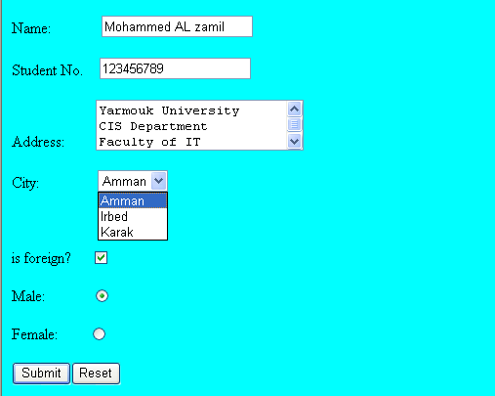
Sami Ali
Al al-Bayt University

Slide 20
Form Elements
<INPUT> Element’s Properties
TYPE= Type of INPUT entry field.
NAME = Variable name passed to CGI application
VALUE= The data associated with the variable name to be passed to the CGI application
CHECKED= Button/box checked
SIZE= Number of visible characters in text field
MAXLENGHT= Maximum number of characters accepted.

Slide 21

Text Box
Text boxes: Used to provide input fields for text, phone numbers, dates, etc.
<INPUT TYPE= " TEXT " >
Browser will display
Textboxes use the following attributes:
TYPE: text.
SIZE: determines the size of the textbox in characters. Default=20 characters.
MAXLENGHT : determines the maximum number of characters that the field will accept.
NAME: is the name of the variable to be sent to the CGI application.
VALUE: will display its contents as the default value.

Slide 22
Example on Text Box
<TITLE>Form_Text_Type</TITLE>
</HEAD> <BODY>
<h1> <font color=blue>Please enter the following bioData</font></h1>
<FORM name="fome1" Method= " get " Action= " URL " >
First Name: <INPUT TYPE="TEXT" NAME="FName"
SIZE="15" MAXLENGTH="25"><BR>
Last Name: <INPUT TYPE="TEXT" NAME="LName"
SIZE="15" MAXLENGTH="25"><BR>
Nationality: <INPUT TYPE="TEXT" NAME="Country"
SIZE="25" MAXLENGTH="25"><BR>
The Phone Number: <INPUT TYPE="TEXT" NAME="Phone"
SIZE="15" MAXLENGTH="12"><BR>
</FORM> </BODY> </HTML>

Slide 23
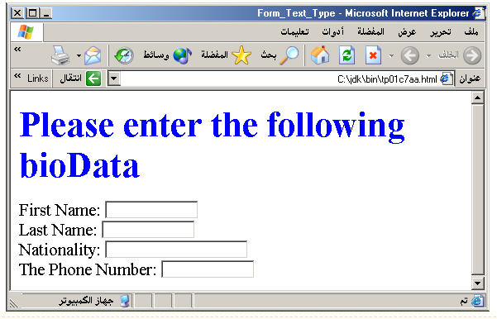
Output

Slide 24
Password
Password: Used to allow entry of passwords.
<INPUT TYPE= " PASSWORD " >
Browser will display
Text typed in a password box is starred out in the browser
display.
Password boxes use the following attributes:
TYPE: password.
SIZE: determines the size of the textbox in characters.
MAXLENGHT: determines the maximum size of the password in characters.
NAME: is the name of the variable to be sent to the CGI application.
VALUE: is usually blank.

Slide 25
Example on Password Box
<HTML><HEAD>
<TITLE>Form_Password_Type</TITLE></HEAD>
<BODY>
<h1> <font color=red>To Access, Please
enter:</font></h1>
<FORM name="fome2" Action="url" method="get">
User Name: <INPUT TYPE="TEXT" Name="FName"
SIZE="15" MAXLENGTH="25"><BR>
Password: <INPUT TYPE="PASSWORD"
NAME="PWord" value="" SIZE="15”
MAXLENGTH="25"><BR>
</FORM></BODY> </HTML>

Slide 26
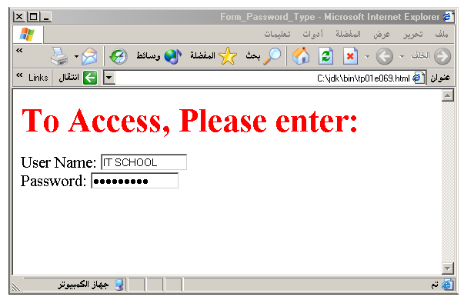
Output

Slide 27
Hidden
Hidden: Used to send data to the CGI application that you don’t want the web surfer to see, change or have to enter but is necessary for the application to process the form correctly.
<INPUT TYPE=“HIDDEN”>
Nothing is displayed in the browser.
Hidden inputs have the following attributes:
TYPE: hidden.
NAME: is the name of the variable to be sent to the CGI application.
VALUE: is usually set a value expected by the CGI application.

Slide 28
Check Box
Check Box: Check boxes allow the users to select more than one option.
<INPUT TYPE=“CHECKBOX”>
Browser will display
Checkboxes have the following attributes:
TYPE: checkbox.
CHECKED: is blank or CHECKED as the initial
status.
NAME: is the name of the variable to be sent to the
CGI application.
VALUE: is usually set to a value.

Slide 29
<HTML> <HEAD><TITLE>CheckBoxType</TITLE> </HEAD>
<BODY>
<h1> <font color=green>Please check one of the following</font></h1>
<FORM name="fome3" Action="url" method="get">
<font color=red> Select Country: </font><BR>
jordan:<INPUT TYPE="CheckBox" Name="country" CHECKED><BR>
Yemen<INPUT TYPE="CheckBox" Name="country"><BR>
Qatar:<INPUT TYPE="CheckBox" Name="country"><BR> <BR>
<font color=blue>Select Language:</font><BR>
Arabic:<INPUT TYPE="CheckBox" Name="language" CHECKED><BR> English:<INPUT TYPE="CheckBox" Name="language"><BR>
French:<INPUT TYPE="CheckBox" Name="language"> <BR></FORM> </BODY></HTML>

Slide 30
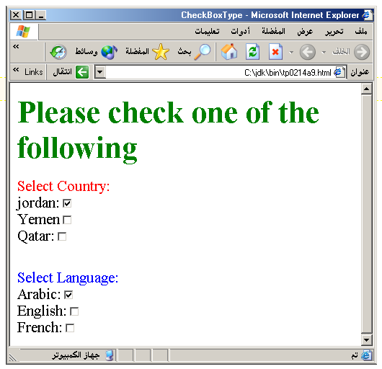
Output

Slide 31
Radio Button
Radio Button: Radio buttons allow the users to select
only one option.
<INPUT TYPE=“RADIO”>
Browser will display
Radio buttons have the following attributes:
TYPE: radio.
CHECKED: is blank or CHECKED as the initial
status. Only one radio button can be
checked
NAME: is the name of the variable to be sent to the
CGI application.
VALUE: usually has a set value.

Slide 32
<HTML> <HEAD><TITLE>CheckBoxType</TITLE> </HEAD>
<BODY>
<h1> <font color=green>Please check one of the following</font></h1>
<FORM name="fome3" Action="url" method="get">
<font color=red> Select Country: </font><BR>
jordan:<INPUT TYPE= "RADIO" Name="country" CHECKED><BR>
Yemen<INPUT TYPE="RADIO " Name="country"><BR>
Qatar:<INPUT TYPE="RADIO" Name="country"><BR> <BR>
<font color=blue>Select Language:</font><BR>
Arabic:<INPUT TYPE="RADIO" Name="language" CHECKED><BR> English:<INPUT TYPE=" RADIO " Name="language"><BR>
French:<INPUT TYPE=" RADIO " Name="language"> <BR></FORM> </BODY></HTML>

Slide 33
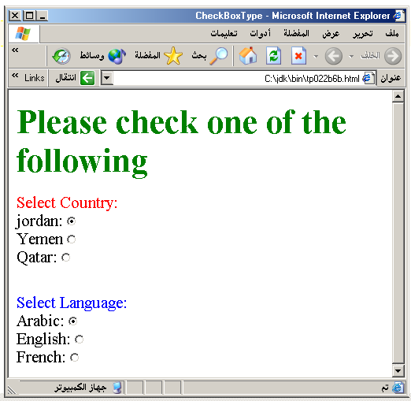

Slide 34
<HTML><HEAD>
<TITLE>RADIOBox</TITLE> </HEAD>
<BODY>
Form #1:
<FORM>
<INPUT TYPE="radio" NAME="choice" VALUE="one"> Yes.
<INPUT TYPE="radio" NAME="choice" VALUE="two"> No.
</FORM>
<HR color=red size="10" >
Form #2:
<FORM>
<INPUT TYPE="radio" NAME="choice" VALUE="three" CHECKED> Yes.
<INPUT TYPE="radio" NAME="choice" VALUE="four"> No.
</FORM>
</BODY></HTML>

Slide 35
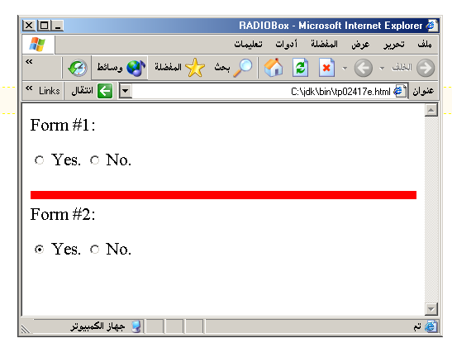
Output

Slide 36
Push Button
Push Button: This element would be used with
JavaScript to cause an action to take place.
<INPUT TYPE=“BUTTON”>
Browser will display
Push Button has the following attributes:
TYPE: button.
NAME: is the name of the button to be used
in scripting.
VALUE: determines the text label on the button.

Slide 37
<DIV align=center><BR><BR>
<FORM>
<FONT Color=red>
<h1>Press Here to see a baby crying:<BR>
<INPUT TYPE="button" VALUE="PressMe"><BR><BR>
<FONT Color=blue>
Click Here to see a baby shouting:<BR>
<INPUT TYPE="button" VALUE="ClickMe" > <BR><BR>
<FONT Color=green>
Hit Here to see a baby eating:<BR>
<INPUT TYPE="button" VALUE="HitME" > <BR><BR>
<FONT Color=yellow>
</FORM></DIV>

Slide 38
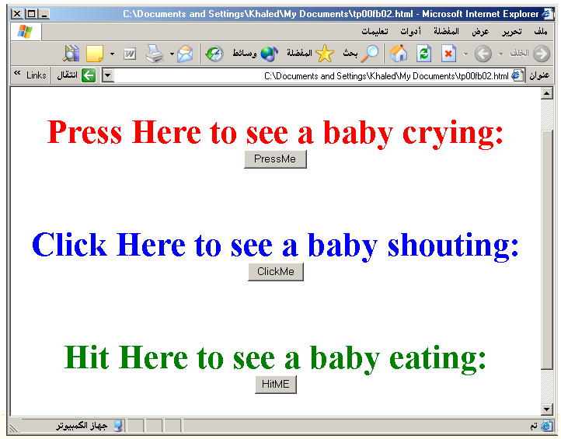

Slide 39
Submit Button
Submit: Every set of Form tags requires a Submit button. This is the element causes the browser to send the names and values of the other elements to the CGI Application specified by the ACTION attribute of the FORM element.
<INPUT TYPE=“SUBMIT”>
The browser will display
Submit has the following attributes:
TYPE: submit.
NAME: value used by the CGI script for processing.
VALUE: determines the text label on the button, usually Submit Query.

Slide 40
<FORM Action="URL" method="get">
First Name: <INPUT TYPE="TEXT" Size=25 name="firstName"><BR>
Family Name: <INPUT TYPE="TEXT" Size=25 name="LastName"><BR>
<BR>
<FONT Color=red>
Press Here to submit the data:<BR>
<INPUT TYPE="submit" VALUE="SubmitData " >
</FORM>

Slide 41
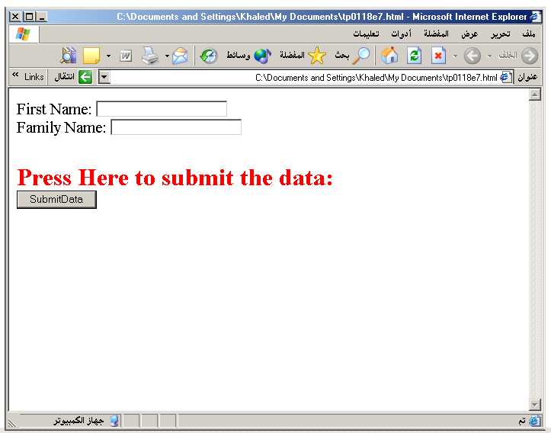

Slide 42
Reset Button
Reset: It is a good idea to include one of these for each form where users are entering data. It allows the surfer to clear all the input in the form.
<INPUT TYPE=“RESET”>
Browser will display
Reset buttons have the following attributes:
TYPE: reset.
VALUE: determines the text label on the button, usually Reset.

Slide 43
<FORM Action="URL" method="get">
First Name: <INPUT TYPE="TEXT" Size=25 name="firstName"> <BR>
Family Name: <INPUT TYPE="TEXT" Size=25 name="LastName"><BR>
<BR>
<FONT Color = red>
<STRONG><font size=5>Press Here to submit the data:</font></STRONG><BR>
<INPUT TYPE="submit" VALUE="SubmitData">
<INPUT TYPE="RESET" VALUE="Reset">
</FORM>

Slide 44
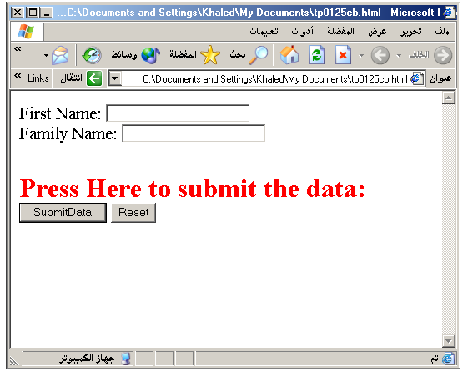

Slide 45
Image Submit Button
Image Submit Button: Allows you to substitute an image for the standard submit button.
<INPUT TYPE=“IMAGE” SRC=“jordan.gif”>
Image submit button has the following attributes:
TYPE: Image.
NAME: is the name of the button to be used in scripting.
SRC: URL of the Image file.

Slide 46
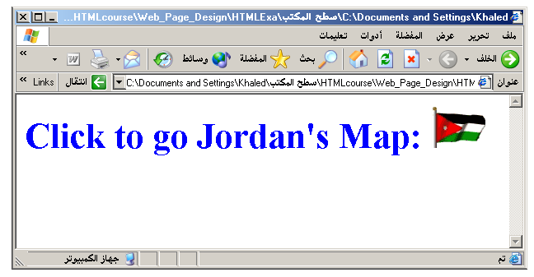
<form> <H1><font color=blue> Click to go Jordan’s Map: <INPUT TYPE="IMAGE" SRC="jordan.gif"> </form>

Slide 47

File
File Upload: You can use a file upload to allow surfers to upload files to your web server.
<INPUT TYPE=“FILE”>
Browser will display
File Upload has the following attributes:
TYPE: file.
SIZE: is the size of the text box in characters.
NAME: is the name of the variable to be sent to the
CGI application.
MAXLENGHT: is the maximum size of the input in the
textbox in characters.

Slide 48
<BODY bgcolor=lightblue>
<form>
<H3><font color=forestgreen>
Please attach your file here to for uploading to
My <font color =red>SERVER...<BR>
<INPUT TYPE="File" name="myFile" size="30">
<INPUT TYPE="Submit" value="SubmitFile">
</form>
</BODY>

